Slide 1

Blinkit Sales Analysis Dashboard
Blinkit Presentation

Slide 2

About Blinkit
Blinkit – India’s last-minute delivery app
Operates through multiple outlet types and sizes
Focus on grocery and daily essentials

Slide 3
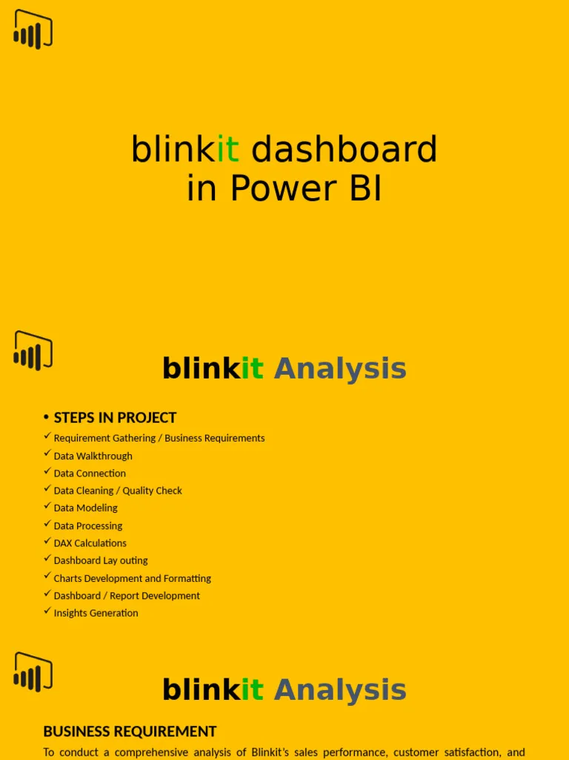
Project Objective
Analyze sales performance using PowerBI
Identify trends by outlet, item type, and location
Provide actionable business insights

Slide 4

Dataset Overview
Sales data across multiple outlet types
Item-level and outlet-level attributes
Ratings, visibility, fat content, and sales metrics

Slide 5

Tools & Technologies
Power BI – Data visualization
Power Query – Data cleaning
DAX – Measures & KPIs
Excel / CSV – Source data

Slide 6
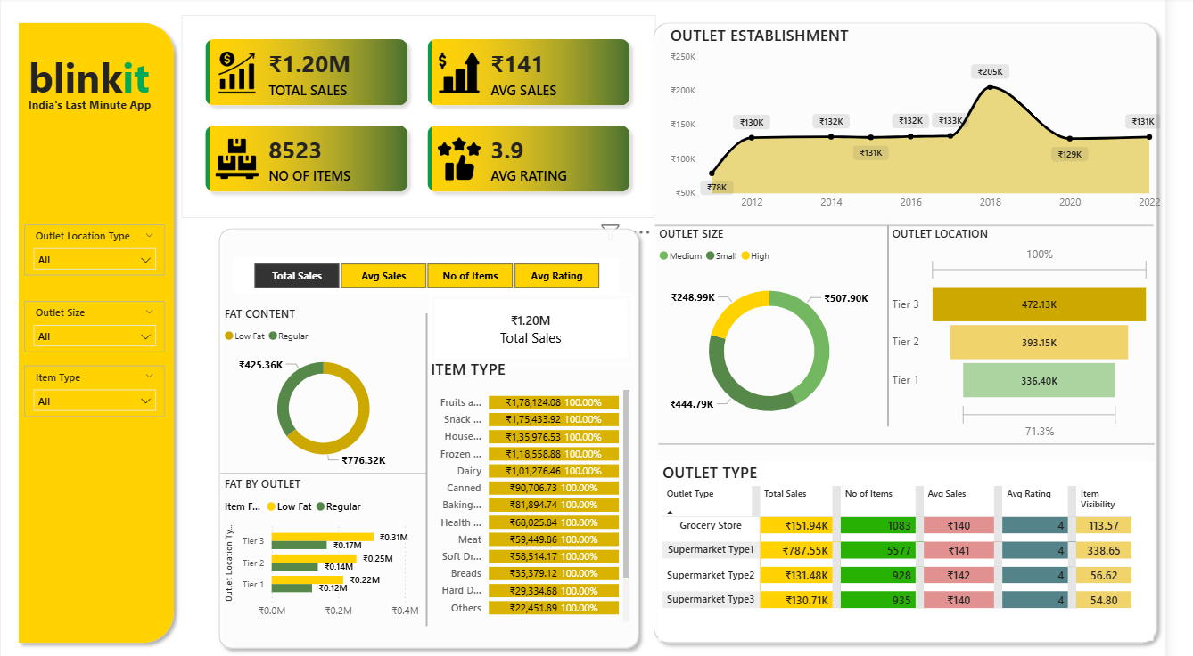
Complete Dashboard View

Slide 7
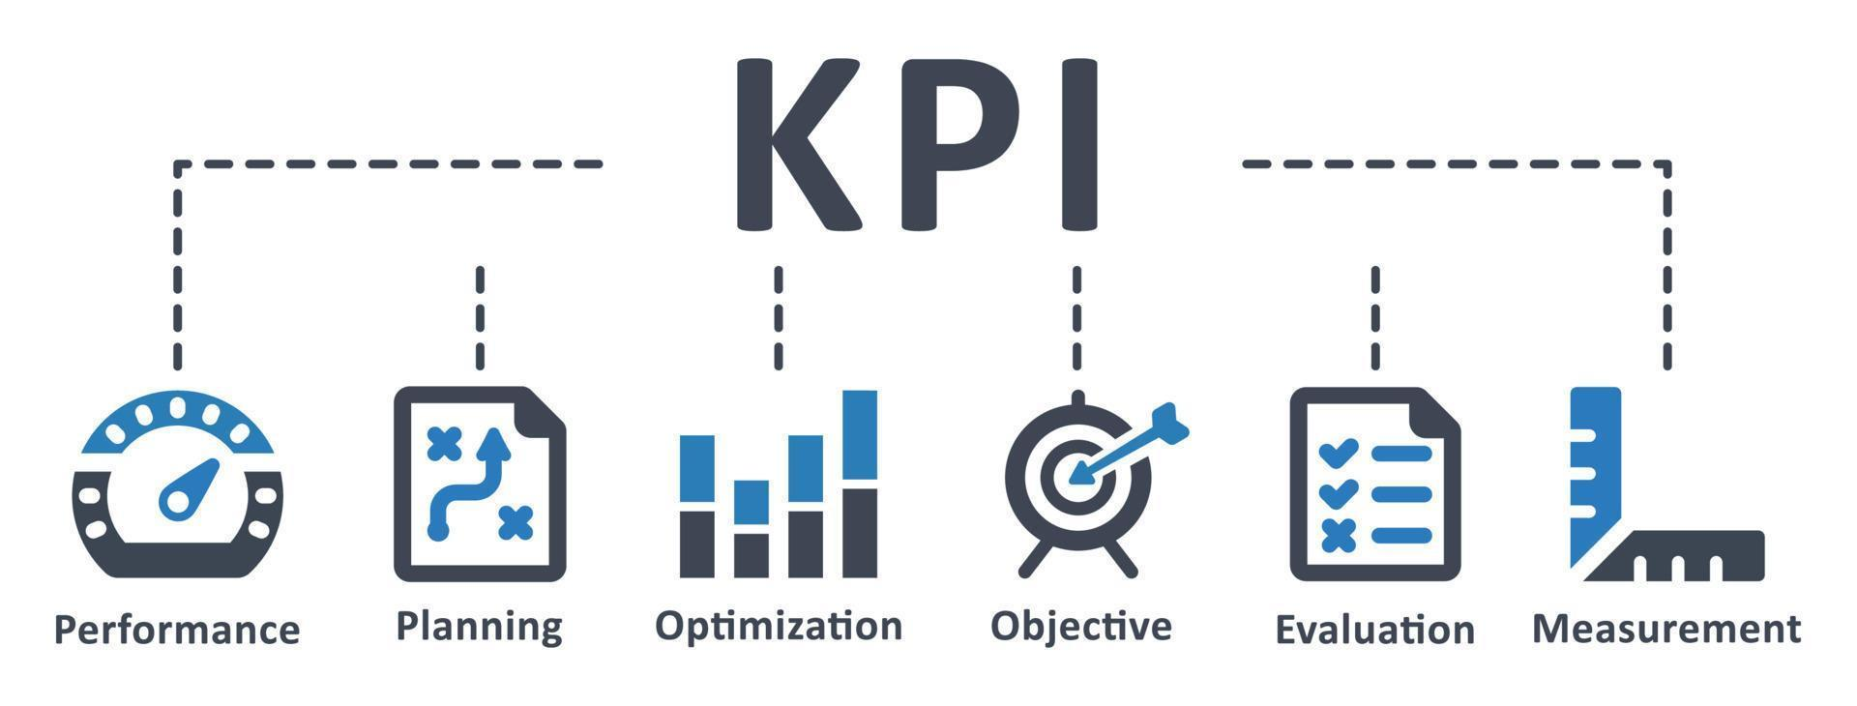
Key KPIs
Total Sales: ₹1.20M
Average Sales: ₹141
Total Items Sold: 8523
Average Rating: 3.9

Slide 8
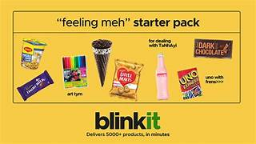
Sales Trend Analysis
Steady growth over the years
Peak sales observed around 2018
Post-peak stabilization phase

Slide 9
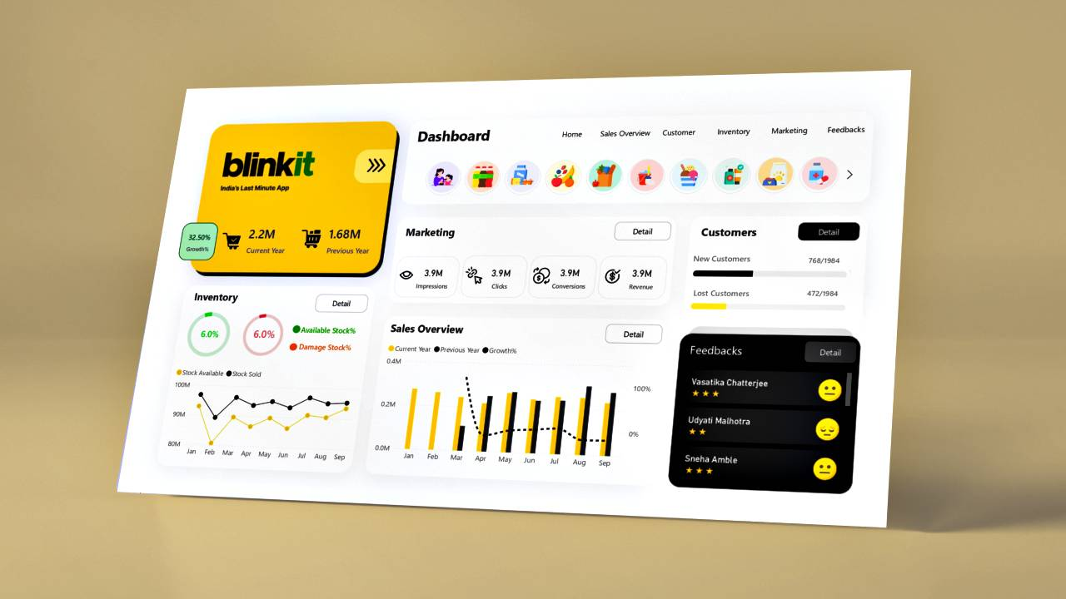
Outlet Establishment Insights
Older outlets contribute stable revenue
Newer outlets show growth potential
Performance varies by establishment year

Slide 10

Outlet Size Analysis
Medium outlets generate highest sales
High-size outlets follow closely
Small outlets contribute least revenue

Slide 11
Outlet Location Performance
Tier 3 locations lead in total sales
Tier 2 shows moderate performance
Tier 1 has lower overall contribution

Slide 12
Item Type Analysis
Fruits & Snacks are top contributors
Household and Frozen items perform well
Others category has minimal impact

Slide 13

Fat Content Analysis
Regular fat items generate higher sales
Low-fat products have niche demand
Customer preference favors regular items

Slide 14
Outlet Type Performance
Supermarket Type 1 leads in revenue
Grocery stores have lower sales volume
Supermarket Type 2 & 3 show similar trends

Slide 15
Item Visibility Impact
Higher visibility improves sales
Supermarket Type 1 has best visibility
Low visibility impacts grocery stores

Slide 16
Customer Rating Insights
Average rating across outlets is consistent
Ratings remain around 4
Customer satisfaction is stable

Slide 17
Business Insights
Focus expansion on Tier 3 locations
Increase stock of high-performing categories
Improve visibility for low-performing outlets

Slide 18
Recommendations
Target promotions for low-fat products
Optimize inventory for top item types
Enhance marketing for Tier 1 outlets

Slide 19
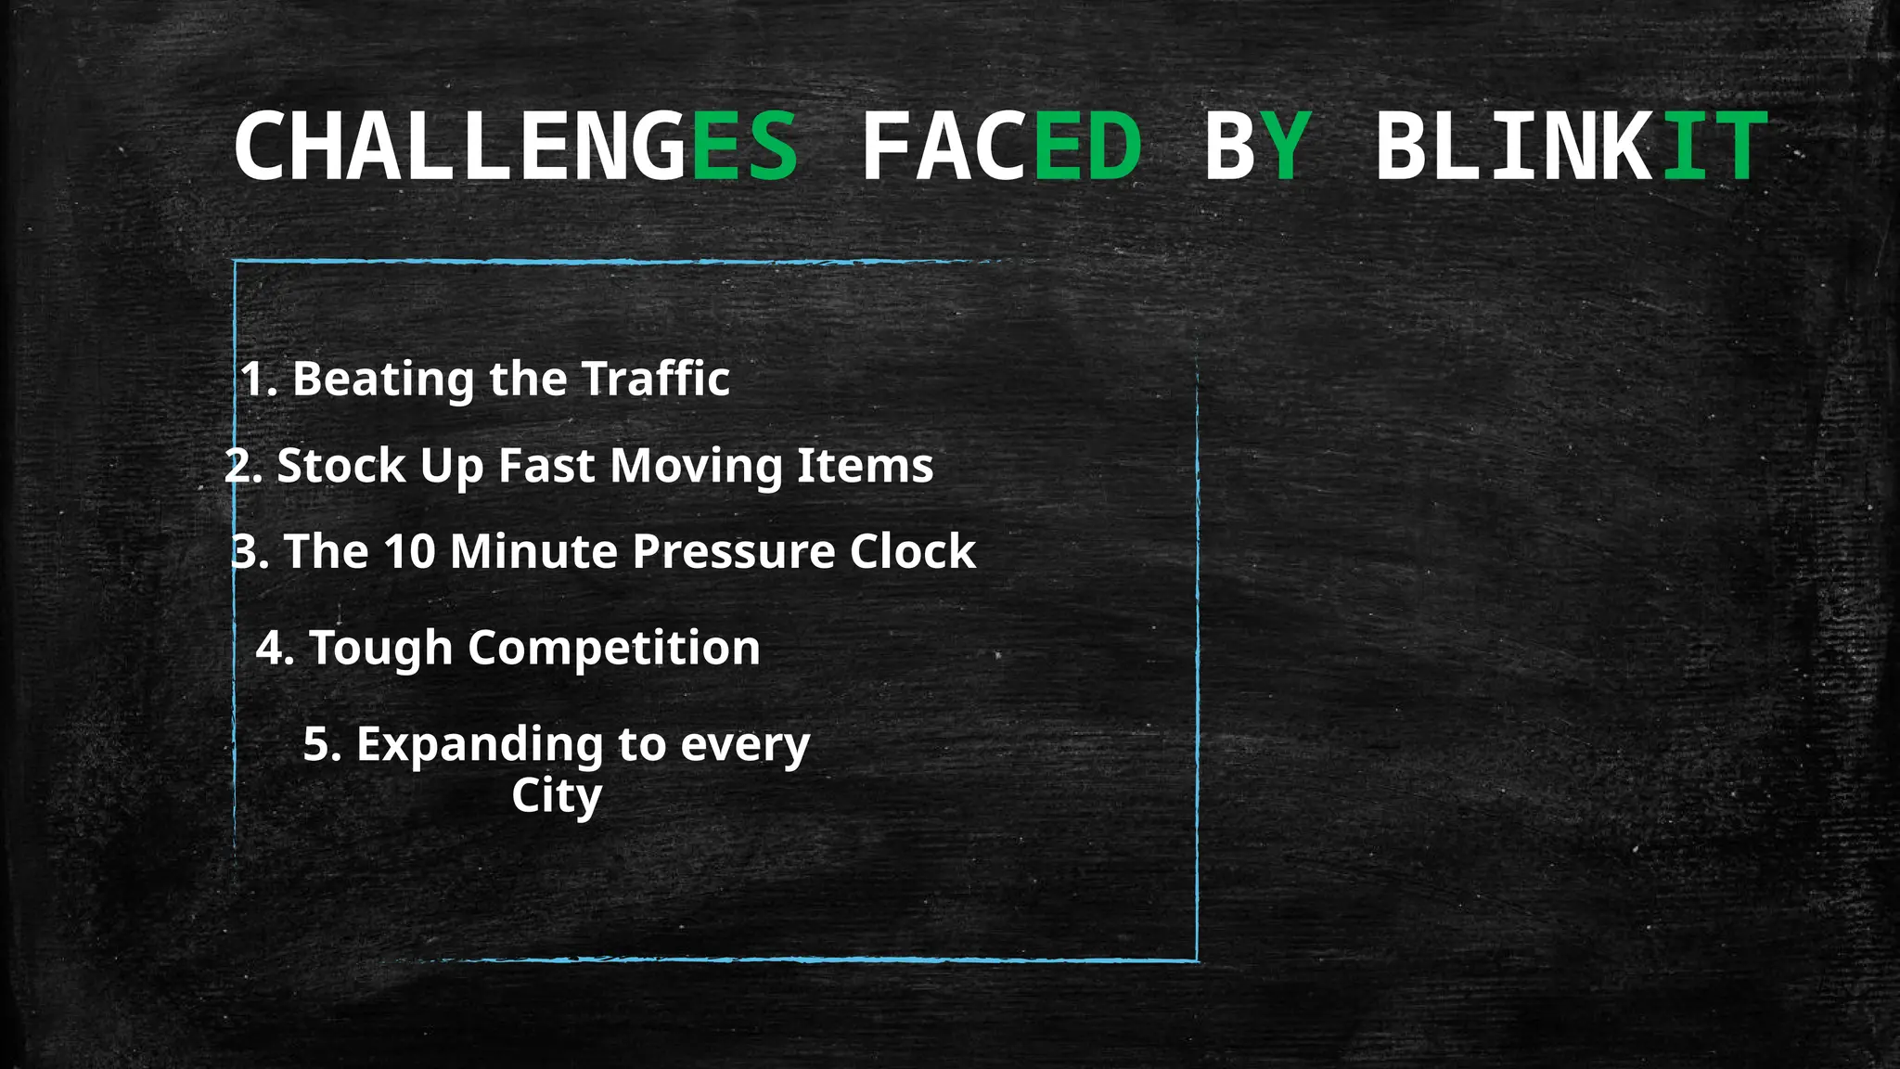
6 .Data quality issues handled in Power Query
Missing values and duplicates
Standardization of categories

Slide 20

Conclusion
Dashboard provides end-to-end sales insights
Supports data-driven decision making
Highly useful for business strategy planning

